Slide 1
NEU Proteomics Capstone Module: Hack-a-thon 1: Pick Your Own Probe Set
You guys!

Slide 2
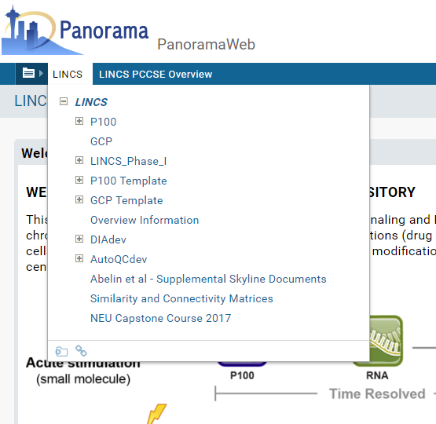
Everything you need:
bit.ly/PCCSEData

Slide 3
Goal for the hack-a-thon
Pick a set of probes for your own P100 assay starting from the discovery proteomics data
Pick ~100 probes
For now, probes are at the level of the phosphosite, not the peptide itself
Select a guiding principle for how you will pick probes
Use R, Excel, or whatever you feel comfortable work with the data
Provide a list for comparison with the other groups, and the original P100 probes

Slide 4
What you will need
Source data
3 versions for your consideration:
Unfiltered (every site detected, even if only in 1 experiment
Filtered (only sites detected in 75% of experiments are present)
Imputed (filtered + fill in missing values based on normal distribution)
A method of reading source data
R, Excel
A method of grouping and/or choosing probes
A method for writing a “csv” file in a standard format

Slide 5
Evaluation Metrics
Evaluation of separation of replicates from non-replicates for each team
Comparison to current P100 probes
Comparison among all teams’ solutions

Slide 6
Additional notes on the data
All data are ratios of treatment to DMSO control
Ratios have been log₂ transformed
Consider row median normalizing and/or z-scoring

Slide 7
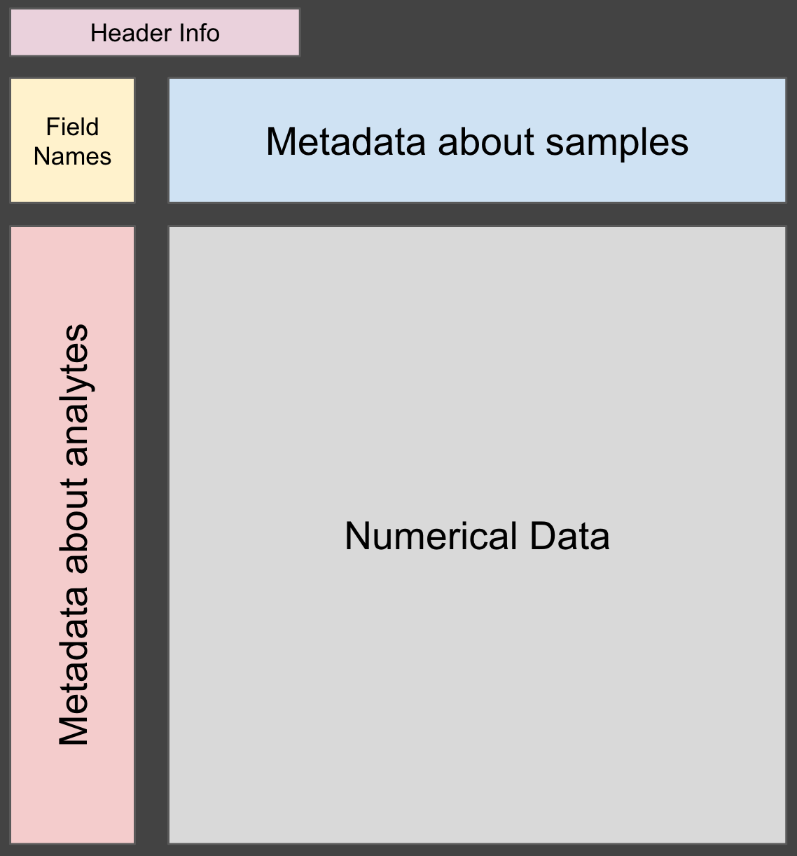
Data file format: GCT
This is a tab-delimited text file; you can drag/drop into Excel

Slide 8
Reading the data using the P100 code-base in R
#download or copy the R code and source data to a directory on your machine
#create a blank Rstudio project in this directory (or setwd to here if just using R)
install.packages(‘jsonlite’) #if not installed already
source(‘p100_processing.R’)
dataObject<-P100provideGCTlistObjectFromFile(‘p100_sourcedata_….gct’)

Slide 9
Reading the data using the P100 code-base in R
dataObject$
static_headers
dataObject$
surviving_headers
dataObject$
dt
dataObject$
surviving_rowAnnots

Slide 10
Explanation of the dataObject
dataObject$dt – matrix data. colnames() are sample IDs, rownames() are probe IDs.
Sample ID format:
Probe ID format:
CellLine_treatment_repeat# i.e., MCF7_captopril_1
Id#_genename_phosphosites i.e., 1234_RPS6_S123
(meaning RPS6 phosphorylated on Ser123).

Slide 11
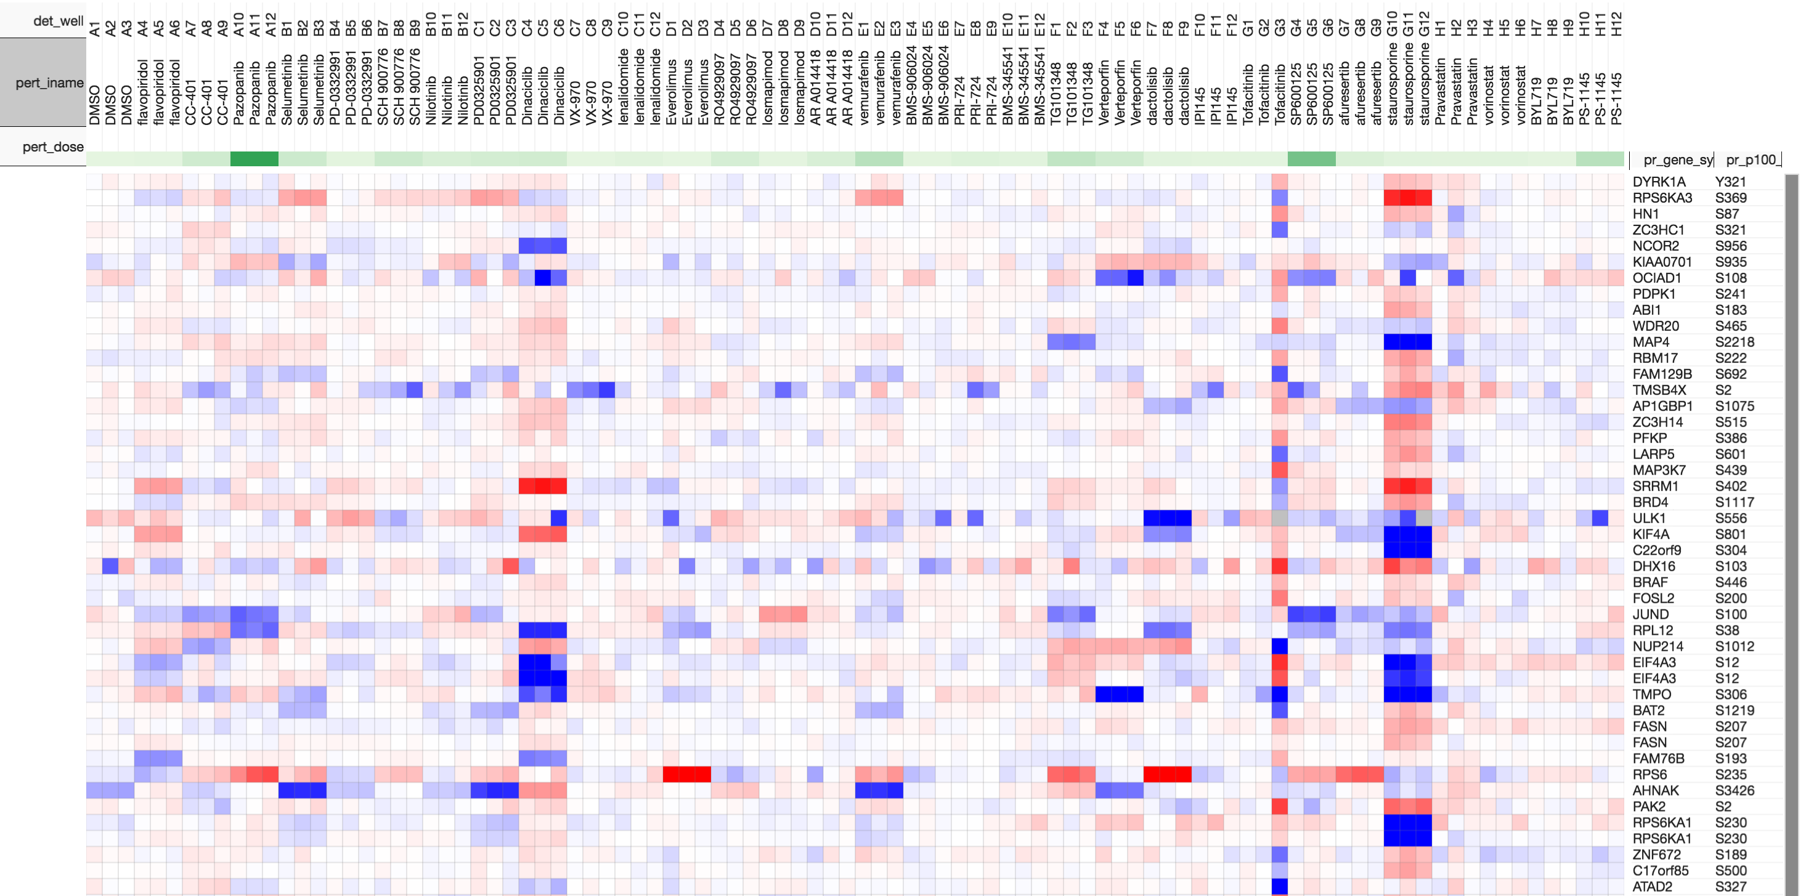
A tool to visualize GCT and other matrix data
Morpheus:
https://software.broadinstitute.org/morpheus/
(quick tour)

Slide 12
Desired output format (.csv file):
probes
495_HDAC2_S394
538_ESYT1_S830
569_CDA02_S506
580_API5_S464
617_FUSIP1_S133
620_FUSIP1_S131
622_KIAA0055_S718
656_DNAJB6_S277
684_NSUN2_S743
685_NSUN2_S751
745_EIF3C_S39
774_hCG_32198_S811
796_KIAA1823_S155
800_KIAA1823_S199
824_C2orf49_S189
848_PRPSAP2_S227
914_BAT2D1_S2107
928_EML3_S177
…

Slide 13
Reading the data using the P100 code-base in R
source(‘p100_processing.R’)
dataObject<-P100provideGCTlistObjectFromFile(‘p100_sourcedata_….gct’)
numericData<-dataObject$dt
myProbeData<-doSomethingToPickProbes(numericData)
#return a matrix with fewer rows than input matrix
myProbeList<-list(probes=rownames(myProbeData))
write.csv(myProbeList,file='probelist.csv',row.names=FALSE)

Slide 14
Some ideas to get you started…
Clustering
There are many flavors…
High variance probes
Marker selection
I.e., pick probes that typify response to certain drugs
Use prior knowledge
I.e., I know what that gene does
Pick by eye
Pick randomly

